Slide 1
Digital Logic & Design
Lecture 13

Slide 2
Combinational Logic
Implementation of SOP using AND-OR
Implementation of POS using OR-AND

Slide 3
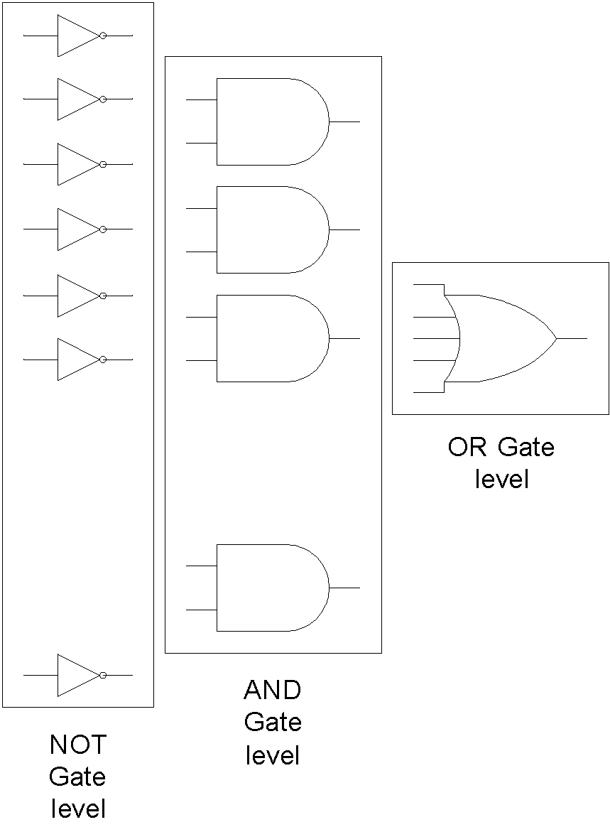
SOP Implementation
Notes:
3
The diagram shows the general architecture of the SOP Implementation.
SOP expression is implemented by the AND-OR combination of gates.
The AND gates produce the product terms.
Outputs of all the AND gates are connected to a single multiple input OR gate for sum of products.
The product terms comprise of literals in their complemented form and un-complemented form which are implemented by NOT gates connected to the inputs of the AND gates.

Slide 4

POS Implementation
Notes:
4
The diagram shows the general architecture of the POS Implementation.
POS expression is implemented by the OR-AND combination of gates.
The OR gates produce the sum terms.
Outputs of all the OR gates are connected to a single multiple input AND gate for product of sum terms
The sum terms comprise of literals in their complemented form and un-complemented form which are implemented by NOT gates connected to the inputs of the OR gates.

Slide 5
Design and Implementation of Digital Circuits
Function Table
Simplification of Expression
Implementation

Slide 6
Adjacent 1s Detector Circuit
SOP Implementation
Directly from function table
Simplified implementation
Implementation using NAND gates

Slide 7
Adjacent 1s Detector Function
Input |  |  |  | Output | Input |  |  |  | Output
A | B | C | D | F | A | B | C | D | F
0 | 0 | 0 | 0 | 0 | 1 | 0 | 0 | 0 | 0
0 | 0 | 0 | 1 | 0 | 1 | 0 | 0 | 1 | 0
0 | 0 | 1 | 0 | 0 | 1 | 0 | 1 | 0 | 0
0 | 0 | 1 | 1 | 1 | 1 | 0 | 1 | 1 | 1
0 | 1 | 0 | 0 | 0 | 1 | 1 | 0 | 0 | 1
0 | 1 | 0 | 1 | 0 | 1 | 1 | 0 | 1 | 1
0 | 1 | 1 | 0 | 1 | 1 | 1 | 1 | 0 | 1
0 | 1 | 1 | 1 | 1 | 1 | 1 | 1 | 1 | 1
Notes:
7
The Adjacent 1s detector circuit accepts a 4-bit binary input and generates a 1 output when it detects a combination of two adjacent 1s.
The function diagram shows the 16 possible input combinations and the corresponding outputs.
Thus for the input combinations 0011, 0110, 0111, 1011, 1100, 1101, 1110 and 1111 the output function is a 1.
The information provided by the function table can be directly implemented to form the Adjacent 1s Detector circuit
How many AND gates are required?
Eight gates to implement the 8 minterms.
How many OR gates are required?
A single eight input OR gate is required to sum all the eight product terms.
Some NOT gates are also required to implement complemented literals in some of the product terms.

Slide 8
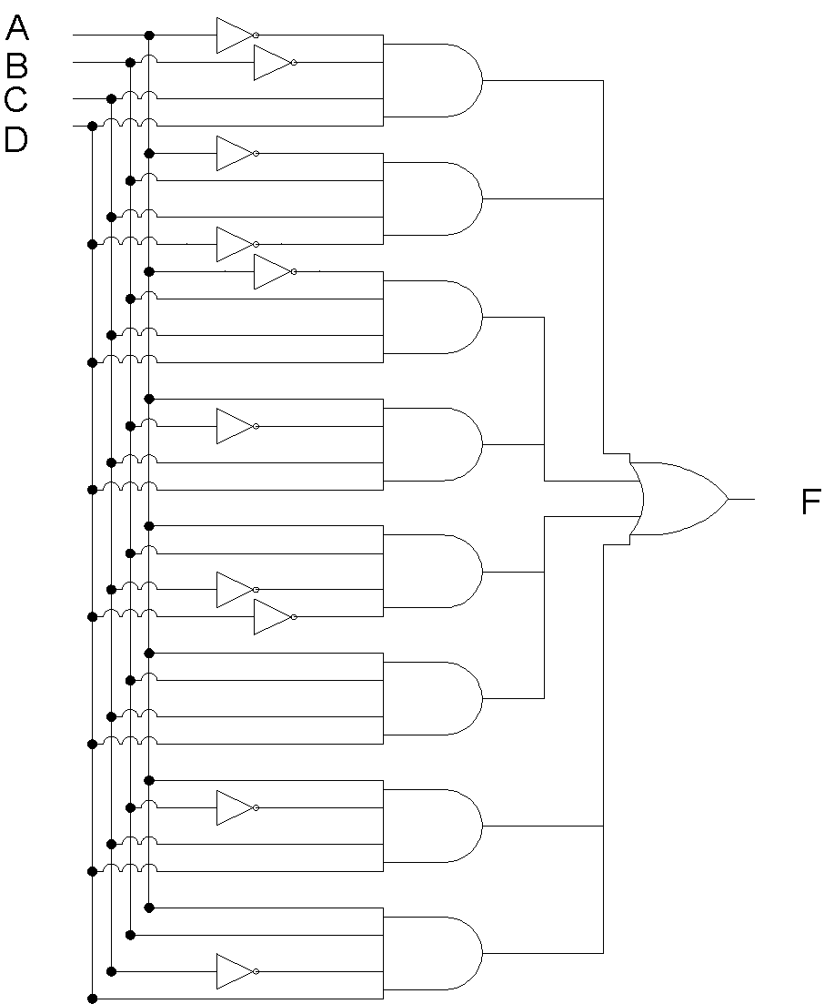
SOP Implementation
Notes:
8
The SOP based implementation of the Adjacent 1s detector circuit is shown implemented directly from the function table.
This implementation uses maximum number of gates.
The total gate count is
one 8 input OR gate
eight 4 input AND gates
ten NOT gates
All together 19 gates are required.
The increased number of gates increases the cost, the size of the circuit, the power requirement and the propagation delay which is of the order of three gates.

Slide 9
SOP Expression Simplification
AB\CD | 00 | 01 | 11 | 10
00 | 0 | 0 | 1 | 0
01 | 0 | 0 | 1 | 1
11 | 1 | 1 | 1 | 1
10 | 0 | 0 | 1 | 0
Notes:
9
An appropriate way to implement the Adjacent 1s detector circuit is to simplify the SOP boolean expression represented by the function table and then implement the circuit based on the simplified expression.
The function table information is directly mapped to a 4-variable K-map
The 1s are grouped together forming three product terms
AB, CD and BC

Slide 10
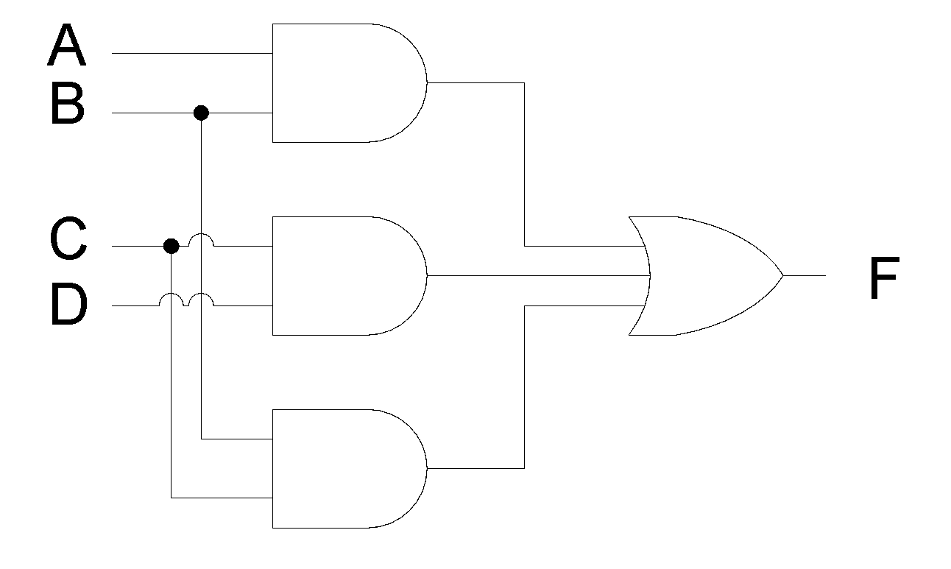
SOP based Simplified Circuit
Notes:
10
The simplified circuit is implemented using
three 2-input AND gates
And a single 3-input OR gate.
The total circuit count is 4 gates.
The cost of the circuit reduces
The size of the circuit reduces
The power requirement of the circuit reduces
And the propagation delay has reduced from three gate delay to two gate delay.

Slide 11
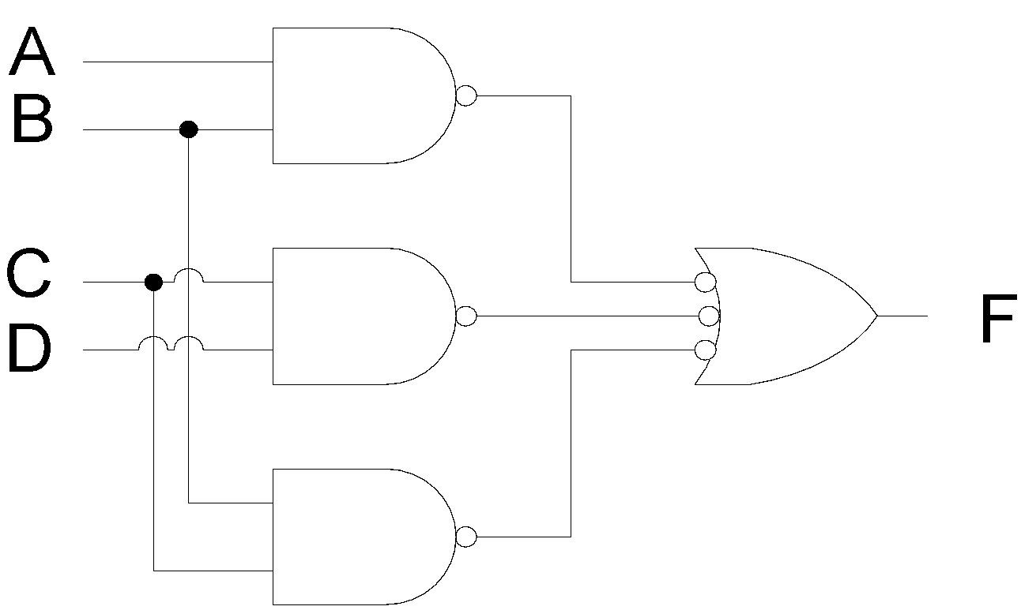

NAND based Implementation
Notes:
11
The simplified 4 gate circuit can be implemented using only NAND gates without a change in the total number of gates.
Bubbles representing NOT gates are placed at the output of the three AND gates. Converting the three AND gates to NAND gates.
To balance out the three NOT gates added at the outputs of the three AND gates. Three bubbles representing three NOT gates are also placed at the three inputs of the OR gate.
The Resulting OR gate symbol with three bubbles at the three inputs is an alternate symbol for a three input NAND gate.
The NAND based circuit is shown.

Slide 12
Adjacent 1s Detector Circuit
POS Implementation
Directly from function table
Simplified Implementation
Implementation using NOR Gates

Slide 13
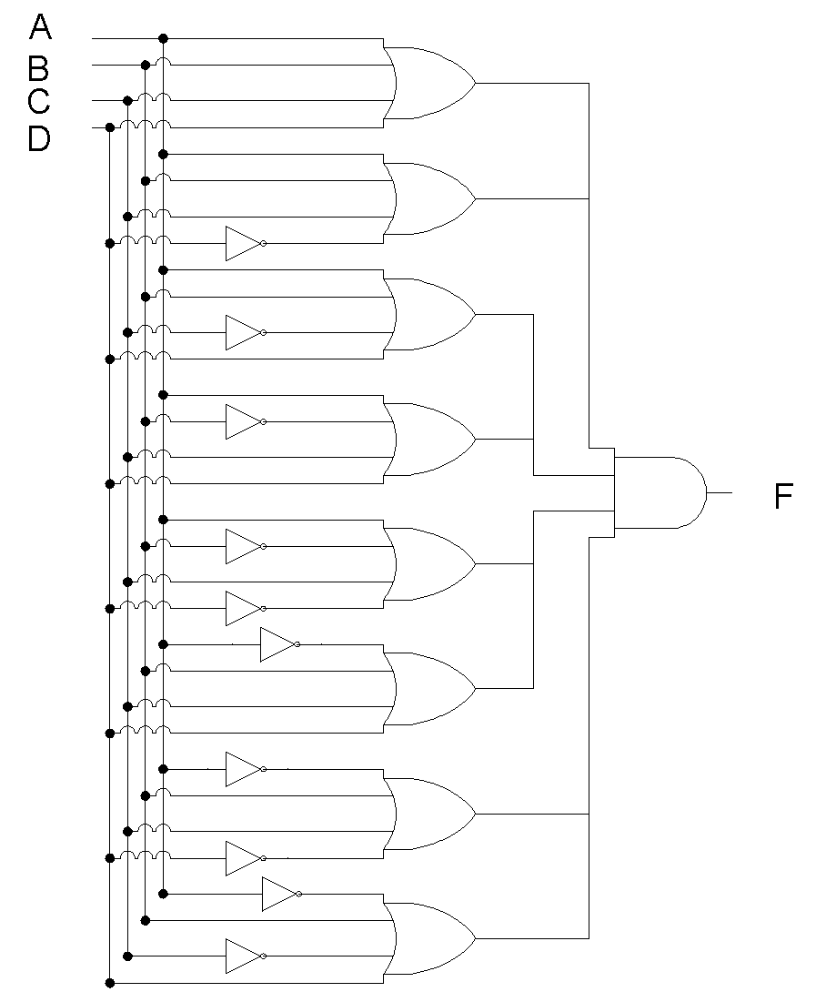
POS Implementation
Notes:
13
The POS based implementation of the Adjacent 1s detector circuit is shown implemented directly from the function table.
This implementation uses maximum number of gates.
The total gate count is
one 8 input AND gate
eight 4 input OR gates
ten NOT gates
All together 19 gates are required.
The increased number of gates increases the cost, the size of the circuit, the power requirement and the propagation delay which is of the order of three gates.

Slide 14
POS Expression Simplification
AB\CD | 00 | 01 | 11 | 10
00 | 0 | 0 | 1 | 0
01 | 0 | 0 | 1 | 1
11 | 1 | 1 | 1 | 1
10 | 0 | 0 | 1 | 0
Notes:
14
An appropriate way to implement the Adjacent 1s detector circuit is to simplify the POS boolean expression represented by the function table and then implement the circuit based on the simplified expression.
The function table information is directly mapped to a 4-variable K-map
The 0s are grouped together forming three sum terms
A+C, B+C and B+D

Slide 15
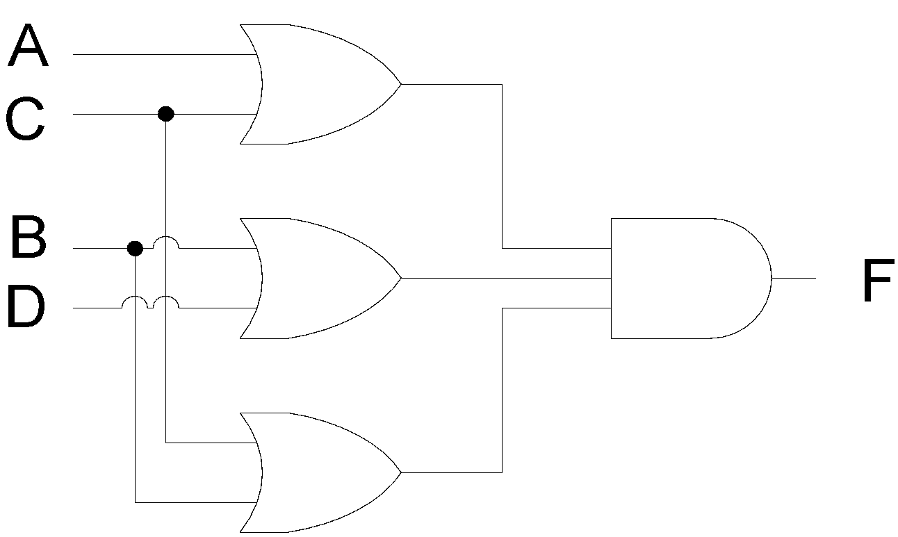
POS based Simplified Circuit
Notes:
15
The simplified circuit is implemented using
three 2-input OR gates
And a single 3-input AND gate.
The total circuit count is 4 gates.
The cost of the circuit reduces
The size of the circuit reduces
The power requirement of the circuit reduces
And the propagation delay has reduced from three gate delay to two gate delay.

Slide 16

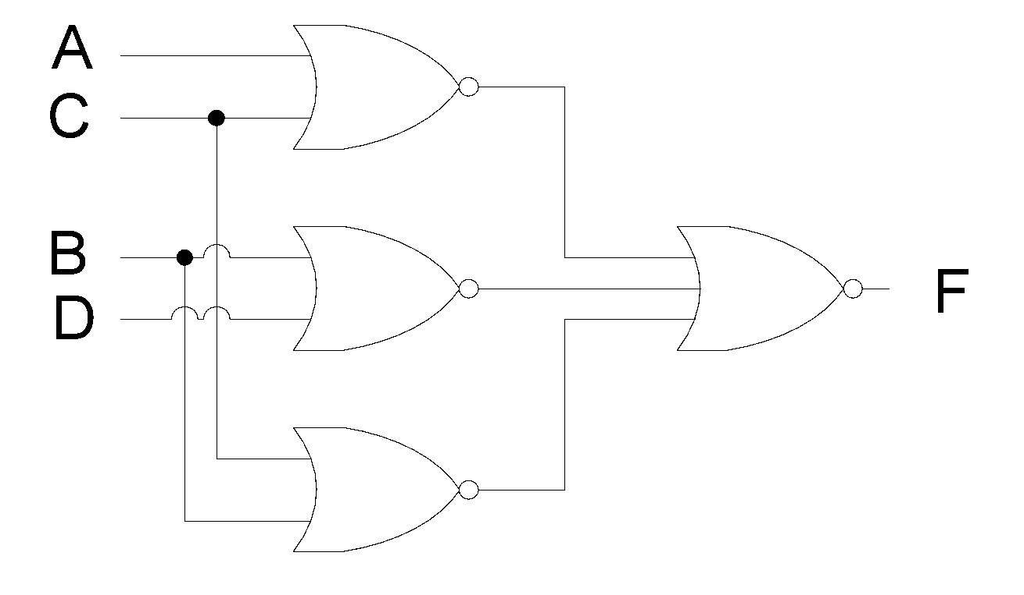
NOR based Implementation
Notes:
16
The simplified 4 gate circuit can be implemented using only NOR gates without a change in the total number of gates.
Bubbles representing NOT gates are placed at the output of the three OR gates. Converting the three OR gates to NOR gates.
To balance out the three NOT gates added at the outputs of the three OR gates. Three bubbles representing three NOT gates are also placed at the three inputs of the AND gate.
The Resulting AND gate symbol with three bubbles at the three inputs is an alternate symbol for a three input NOR gate.
The NOR based circuit is shown.

Slide 17
Operation of Circuit
Represented through a timing diagram
Timing diagram of 8 time intervals
Each interval representing a new input

Slide 18
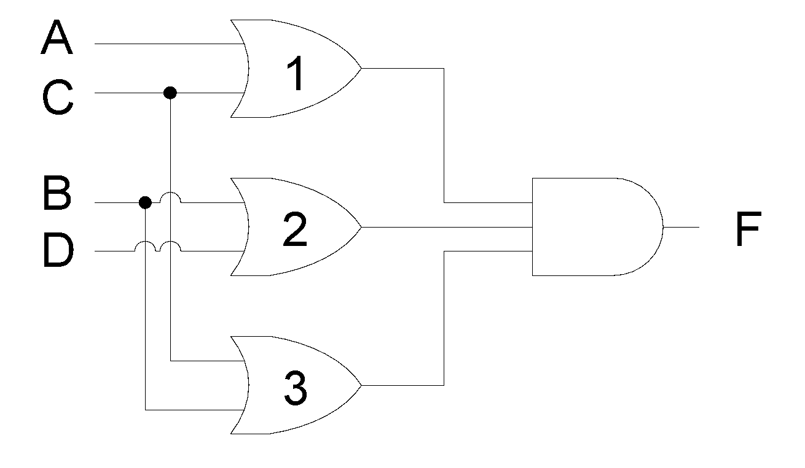
POS based Simplified Circuit
Notes:
18

Slide 19
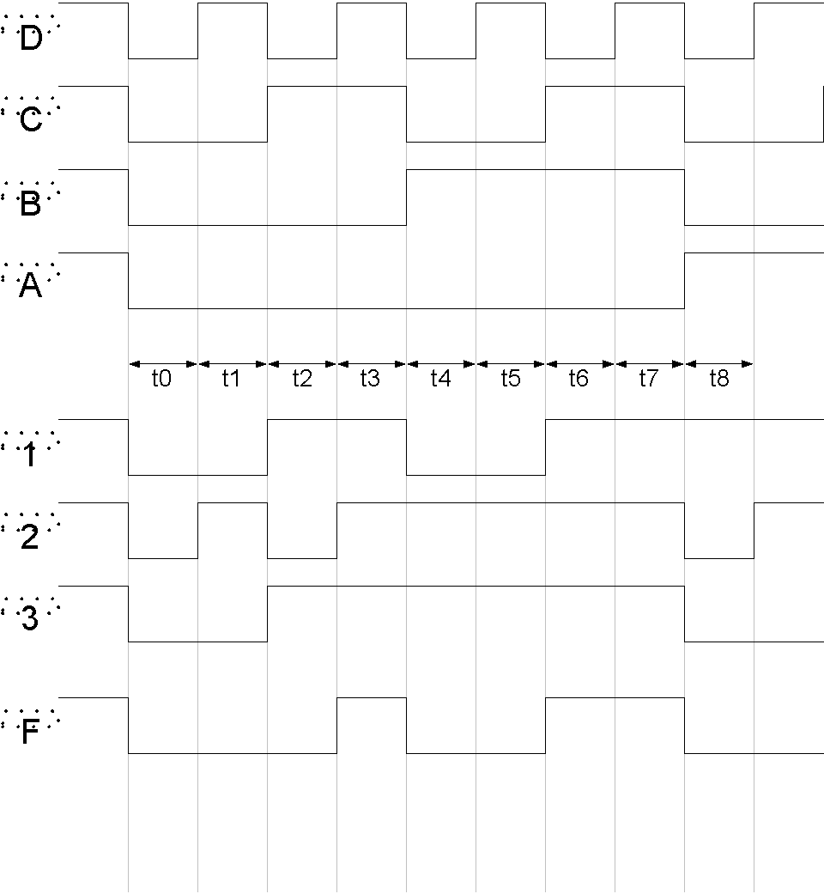
Operation of Circuit
Notes:
19
The timing diagram describes the operation of the circuit for the POS based simplified circuit for intervals t0 to t8
A, B, C and D are the inputs to the circuit.
The timing diagram shows the inputs A, B, C and D changing with time.
The timing signals 1, 2 and 3 represent the outputs of the OR gates 1, 2 and 3.
The timing signal F represents the output of the circuit.
At interval t0 the input ABCD to the circuit is 0000, the outputs of the three OR gates is 00 and 0 and the circuit output is also 0
At tie interval t3 the input ABCD to the circuit is 0011, the outputs of OR gates 1,2 and 3 are 111. The output F is also a 1.
The circuit has detected adjacent 1s.
At interval t6 the input ABCD to the circuit is 0110, the outputs of OR gates 1,2 and 3 are 111. The output F is 1 indicating adjacent 1s.
The operation of the circuit which is based on the POS simplified expression also proves that a POS based expression determined from the truth table and K-map results in a circuit which operates in an identical manner to that of a SOP based circuit.

